Slide 1
E-commerce Web Application
Batch-3 Team-2
Group Members:
Kumar Shivam
Tushar Sharma
Anindita Gogoi
Ishaan Joshi
Anuj Saini

Slide 2
E-commerce
Ecommerce, also known as electronic commerce or internet commerce, refers to the buying and selling of goods or services using the internet, and the transfer of money and data to execute these transactions.
Ecommerce is often used to refer to the sale of physical products online, but it can also describe any kind of commercial transaction that is facilitated through the internet.
A website that allows people to buy and sell physical goods, services, and digital products over the internet rather than at a brick-and-mortar location. Through an e-commerce website, a business can process orders, accept payments, manage shipping and logistics, and provide customer service.

Slide 3
Business Requirements specification (BRS)
A) Background of the project
EasyKart is an E-commerce website which is designed to provide its customers the ease to shop online from the convenience of their homes.User's can surf through the large
variety of products from the categories which are highly in demand nowadays
Categories:
1. Electronics-
This category will contains all the electronics appliances which are in huge demand like mobile phones, laptop, home appliances etc.
2. Clothing:-
Users can buy the clothes of their favourite brands.
3. Sports

Slide 4
B)Goal of Project
EasyKart wants to give 'Online Products Buying and Selling Solution' for various production oriented industries, dealers and customers through this project.
• It wants to give a complete solution for shopping through internet.
• It offers a wide range of products that makes it an one-stop shop.
• It has a very simple user interface that anyone can easily access it.
Goals are:
1. To increase the number of customers.
2. Simple user interface.
3. Making various categories for different products.
4. Customers can view complete description of products.
5. Reducing human intervention.
6. Increase the profit.
7. Help service

Slide 5
C)Problem statement:-
Given the pandemic situation, for the safety of public, shopping can be more accessible when it can it done through an e-commerce or a virtual platform.
D)Solution:-
To overcome the vulnerability of safety towards the public, an e-commerce website could resolve and help them shop by being safe in their home.
E) Uses of project
1. Client company:-
Company doing business directly with the customer.
2. customer:-
Providing products direct to their houses.

Slide 6
F) Requirements
Functional requirement
1. Bill invoice management
• Invoice generating with purchased order
2. Customer profile
• To see his/her order
• To see his/her profile
3. Seller
• Providing products
• Listing products
Non-Functional requirement
• Generate bills of customers for their order in less than 5 seconds.
• Create new customer profile in less than 3 seconds.
• Sending user a confirmation message in less than 3 seconds.

Slide 7
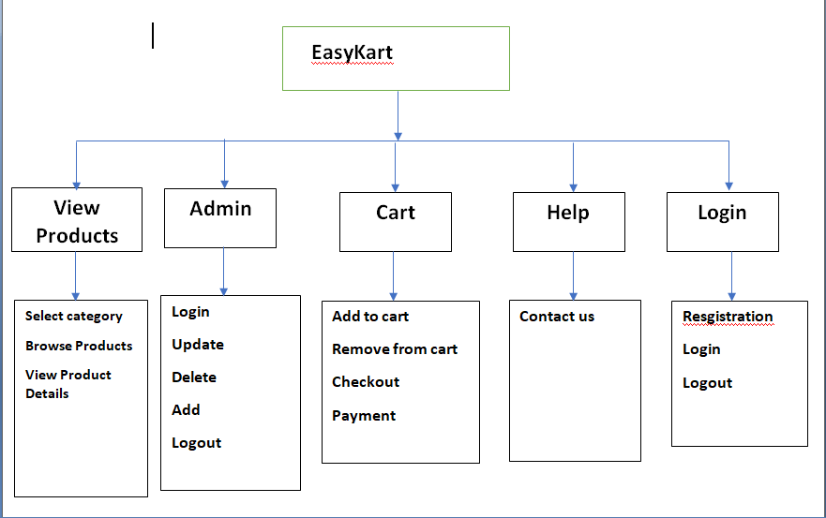
ARCHITECTURE DIAGRAM

Slide 8
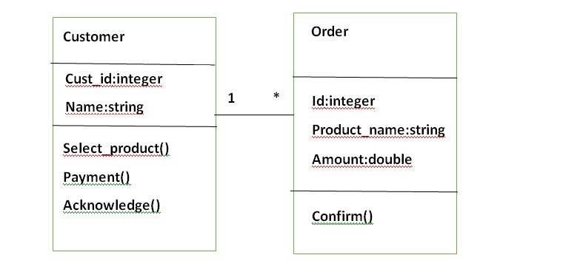
UML DIAGRAMS
Class Diagram

Slide 9
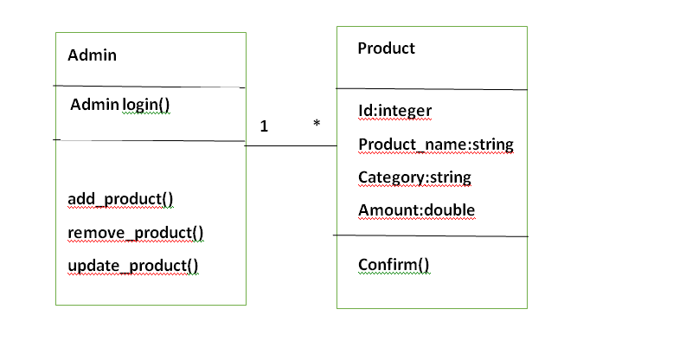

Slide 10
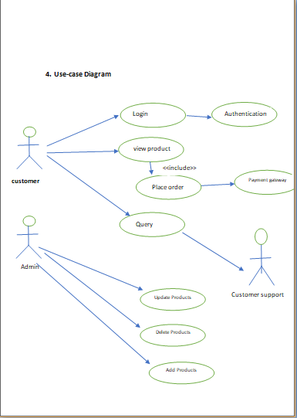

Slide 11
Compatible Products
This project has been tested on the Windows OS and Mac OS platforms with the unittest module.
2. Upgrades
EasyKart is a E-commerce site.
Company didn’t achieve the overall E-commerce density growth ratio because of some limitations like difficult checkout, less category to choose product, manual marketing activities, Lack of payment security.
So to overcome all these issue company decided transform the E-commerce site again.
This project is developed as a database-driven e-commerce web sites which provides various benefits and services like:
Buy product from large category
More option to choose
Bill payments
Consumer profile
Help service

Slide 12
3. New Features
This project is a database-driven e-commerce web sites where products are displayed on webpage and stored in a database. Typically, new products would pull from the database and displayed on the homepage daily.
The buyer can purchase , electronics ,clothes , household stuff, sports ,and other daily life stuff. from the menus given and prices stored in the database is displayed.
It ask to customer to fill the forms and attached required documents.
The site administrator can easily change product /services and price information.
After choosing the product the user/customer can check out and pay the bill and get the confirmation of the payment.

Slide 13
Tool used:
Python
Flask
HTML
CSS
SQL
Selenium

Slide 14
Python
Python is a high-level, general-purpose and a very popular programming language. Python programming language (latest Python 3) is being used in web development, Machine Learning applications, along with all cutting edge technology in Software Industry.
Python was designed for readability, and has some similarities to the English language with influence from mathematics.

Slide 15
Flask
Flask is a web framework, it’s a Python module that lets you develop web applications easily. It’s has a small and easy-to-extend core: it’s a microframework that doesn’t include an ORM (Object Relational Manager) or such features.
It does have many cool features like url routing, template engine. It is a WSGI web app framework.
Flask gives the developer varieties of choice when developing web applications, it provides you with tools, libraries, and mechanics that allow you to build a web application but it will not enforce any dependencies or tell you how the project should look like.

Slide 16
HTML
HTML, or Hypertext Markup Language, is a markup language for the web that defines the structure of web pages. It is a language that is used to create documents on the World Wide Web incorporating text, graphics, sound, video, and hyperlinks
The most basic of HTML conventions is the inclusion of a document type declaration at the beginning of the text file. This always comes first in the document, because it is the piece that affirmatively informs a computer that this is an HTML file. The document header typically looks like this: <!DOCTYPE html>.

Slide 17
HTML: main tags
Although there are lots of tags in the HTML specification, 99% of the webs use a subset of HTML tags with less that 10 tags, the most important are:
● <div>: a container, usually represents a rectangular area with information inside. ● <img/>: an image ● <a>: a clickable link to go to another URL ● <p>: a text paragraph ● <h1>: a title (h2,h3,h4 are titles of less importance) ● <input>: a widget to let the user introduce information ● <style>: to insert CSS rules
● <script>: to execute Javascript

Slide 18
CSS
Cascading Style Sheets, fondly referred to as CSS, is a simple design language intended to simplify the process of making web pages presentable.
Applications of CSS:
CSS saves time - You can write CSS once and then reuse same sheet in multiple HTML pages. You can define a style for each HTML element and apply it to as many Web pages as you want.
Pages load faster - If you are using CSS, you do not need to write HTML tag attributes every time. Just write one CSS rule of a tag and apply it to all the occurrences of that tag. So less code means faster download times.
Easy maintenance - To make a global change, simply change the style, and all elements in all the web pages will be updated automatically.
Superior styles to HTML - CSS has a much wider array of attributes than HTML, so you can give a far better look to your HTML page in comparison to HTML attributes.

Slide 19
SQL
SQL is Structured Query Language, which is a computer language for storing, manipulating and retrieving data stored in a relational database.
Allows users to access data in the relational database management systems.
Allows users to describe the data.
Allows users to define the data in a database and manipulate that data.
Allows to embed within other languages using SQL modules, libraries & pre-compilers.
Allows users to create and drop databases and tables.
Allows users to create view, stored procedure, functions in a database.
Allows users to set permissions on tables, procedures and views.
Types:
DDL-Data definition Language
DML- Data manipulation Language
DCL- Data control Language

Slide 20
SELENIUM
Selenium is an open source umbrella project for a range of tools and libraries aimed at supporting browser automation.It provides a playback tool for authoring functional tests without the need to learn a test scripting language(Selenium IDE). It also provides a test domain specific language(Selenese) to write tests in a number of popular programming languages, including JavaScript(Node.js),C#, Groovy, Java, Perl, PHP, Python, Ruby and Scala. The tests can then run against most modern web browsers. Selenium runs on Windows, Linux, and macOS. It is open-source software released under the Apache License 2.0.

Slide 21
By using the above concepts we finally ended up designing an ecom website which contains the following operation:
1.admin login
2.admin home
3.base
4.cart
5.checkout
6.home
7.index
And much more….

Slide 22
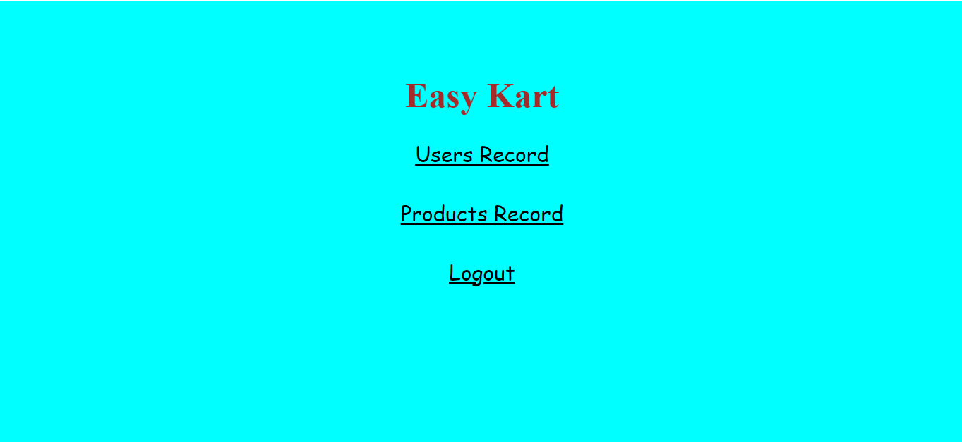

Slide 23
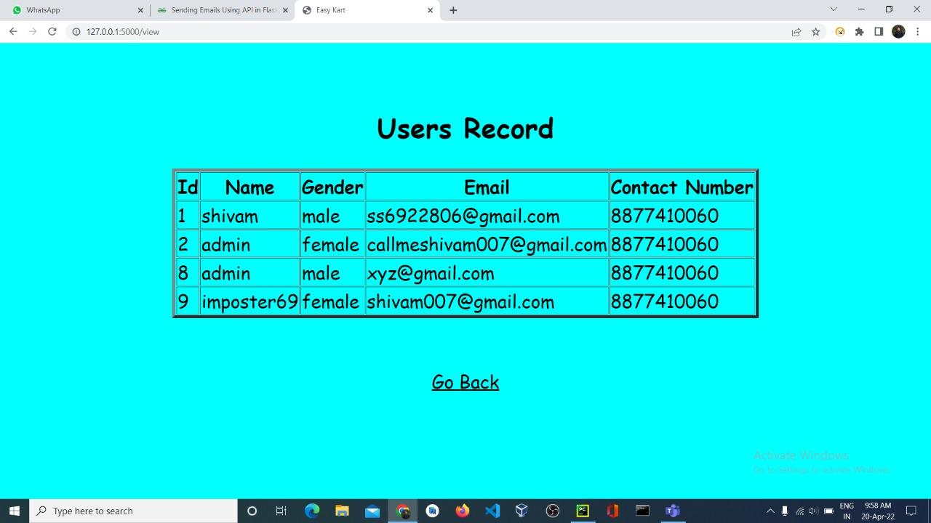

Slide 24
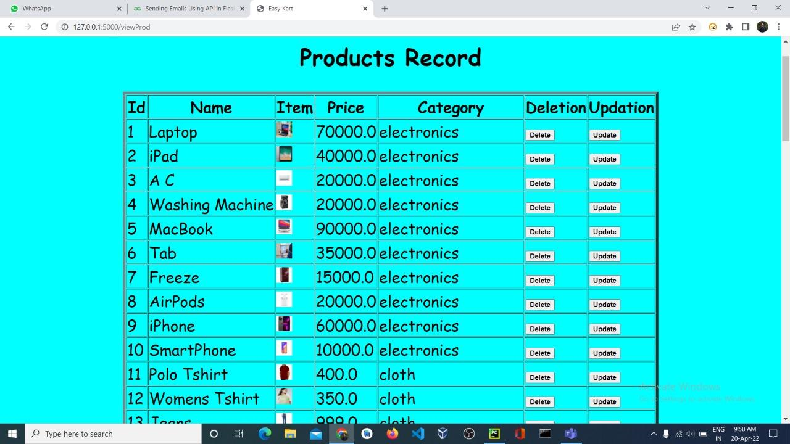

Slide 25
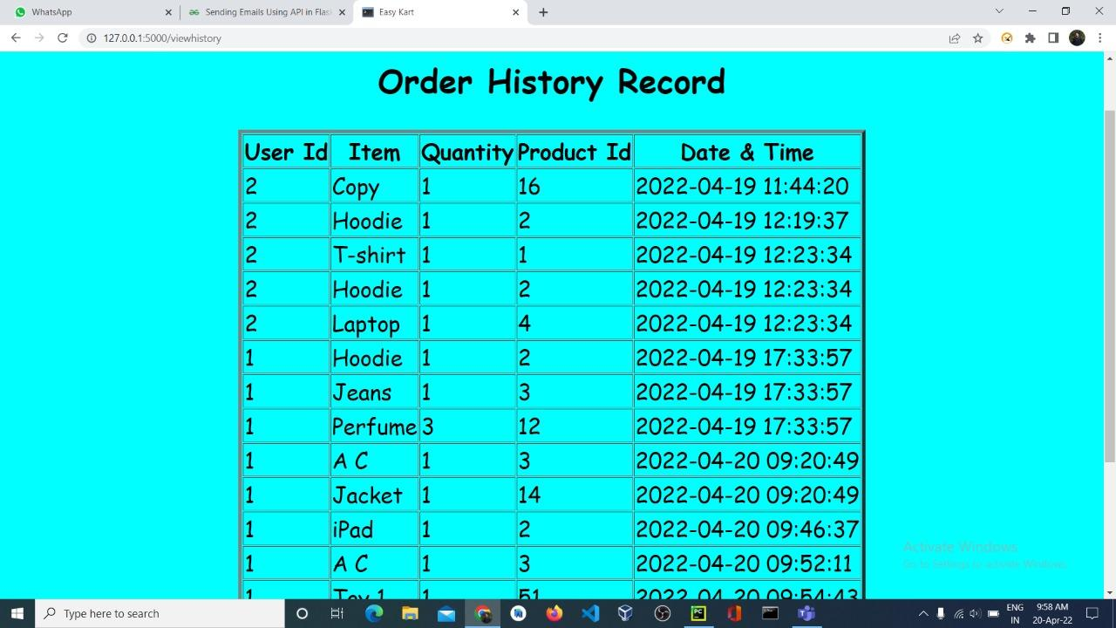
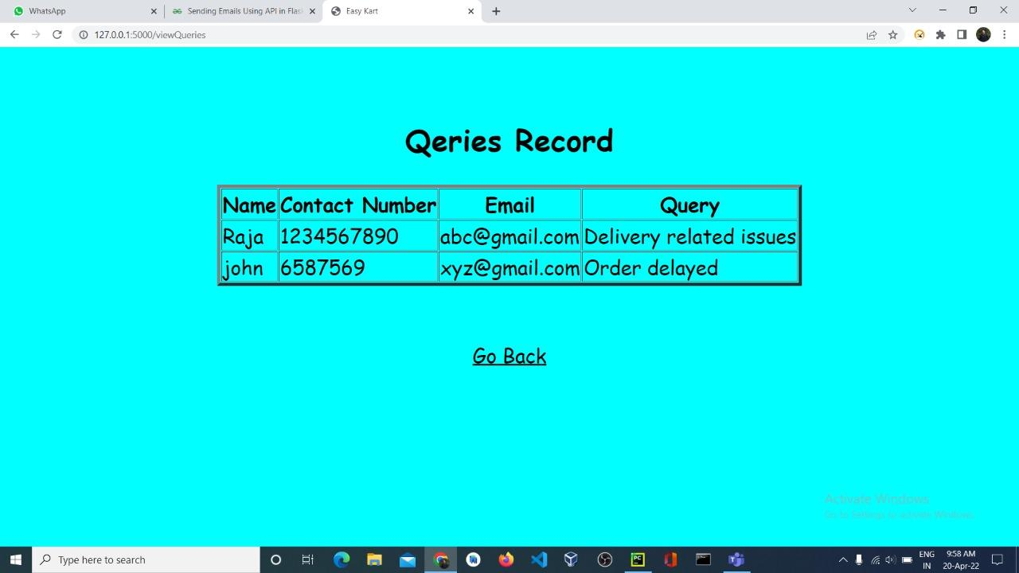

Slide 26
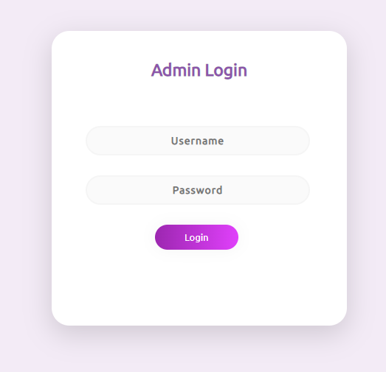

Slide 27
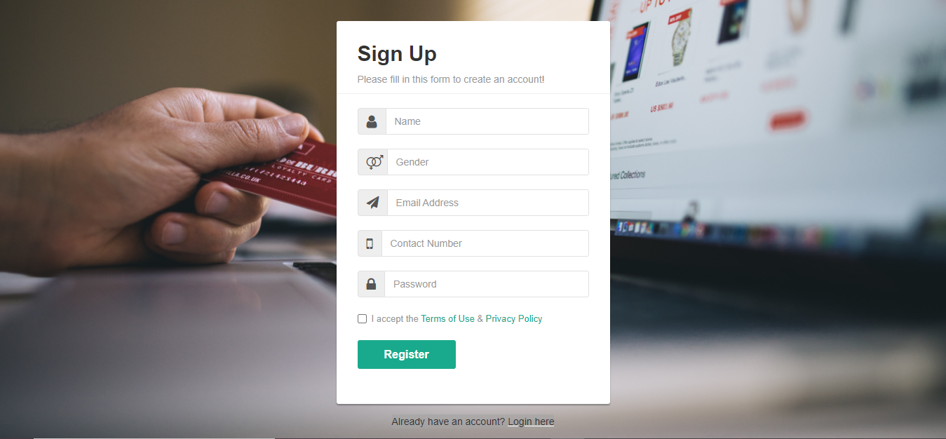

Slide 28
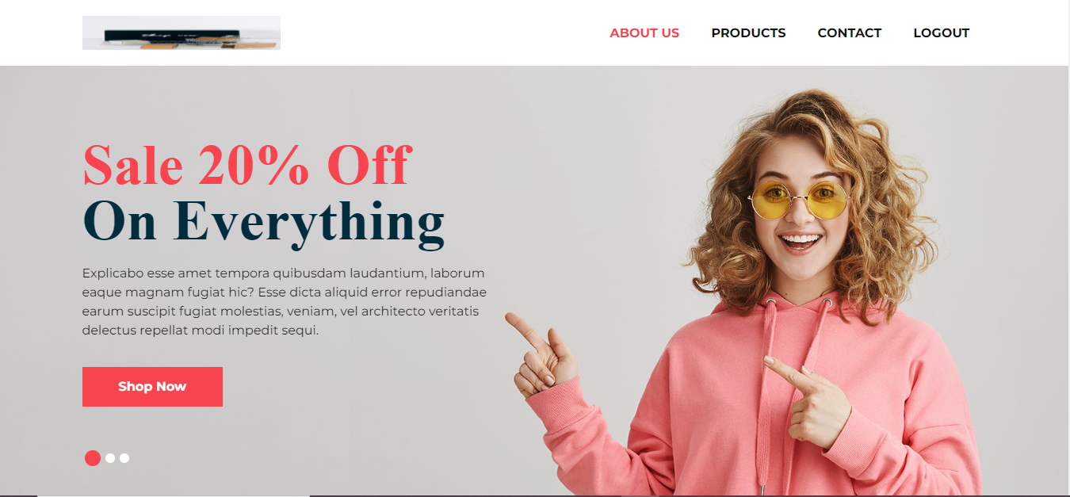

Slide 29
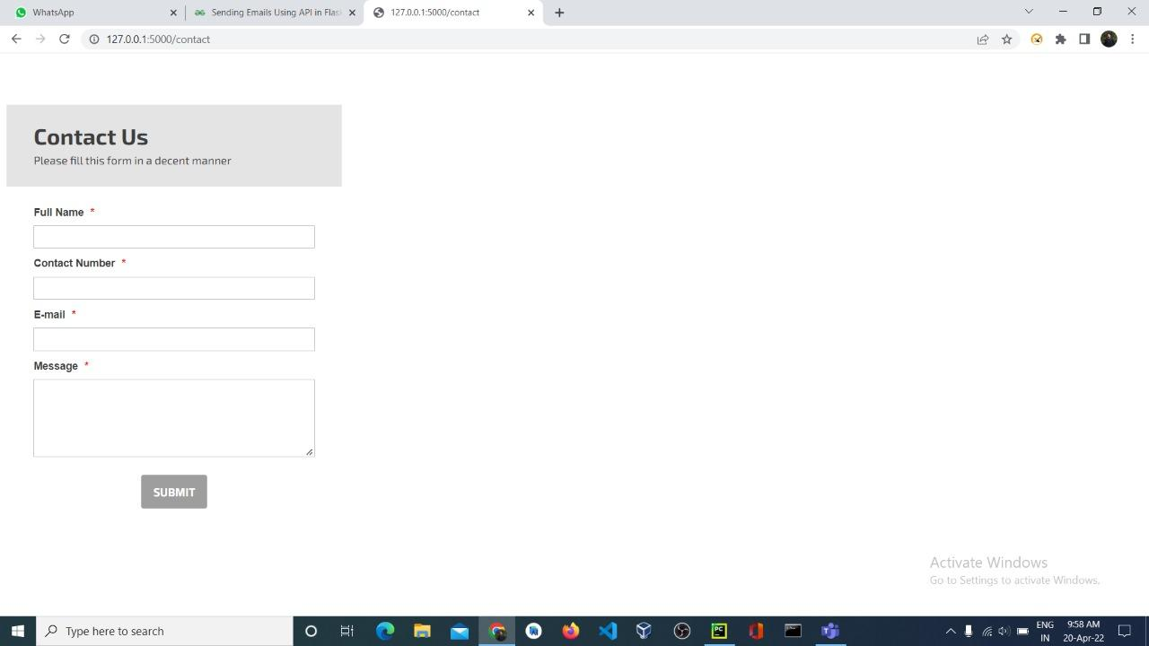

Slide 30
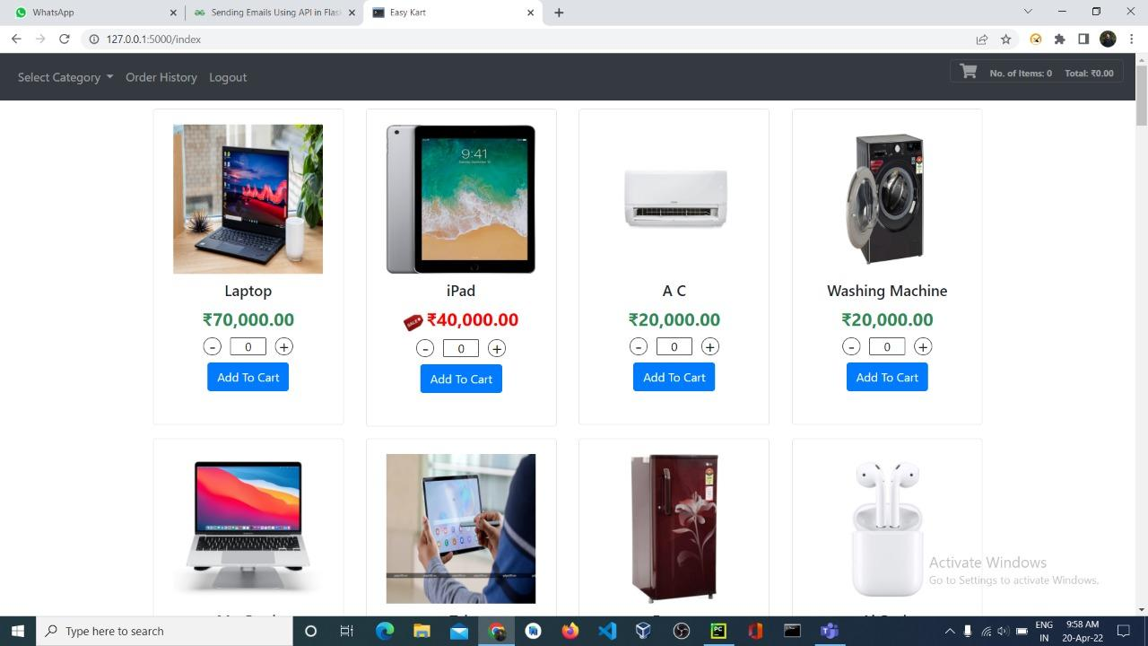

Slide 31
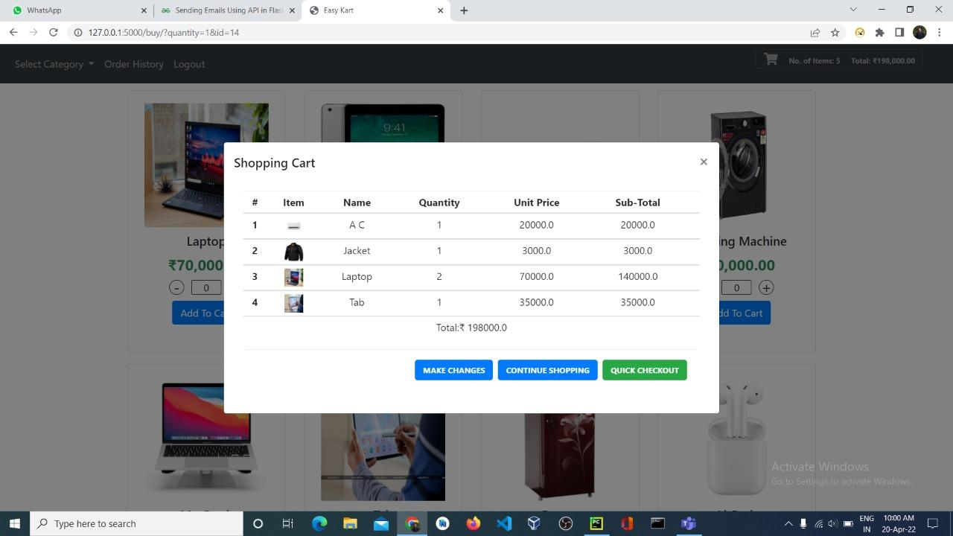

Slide 32
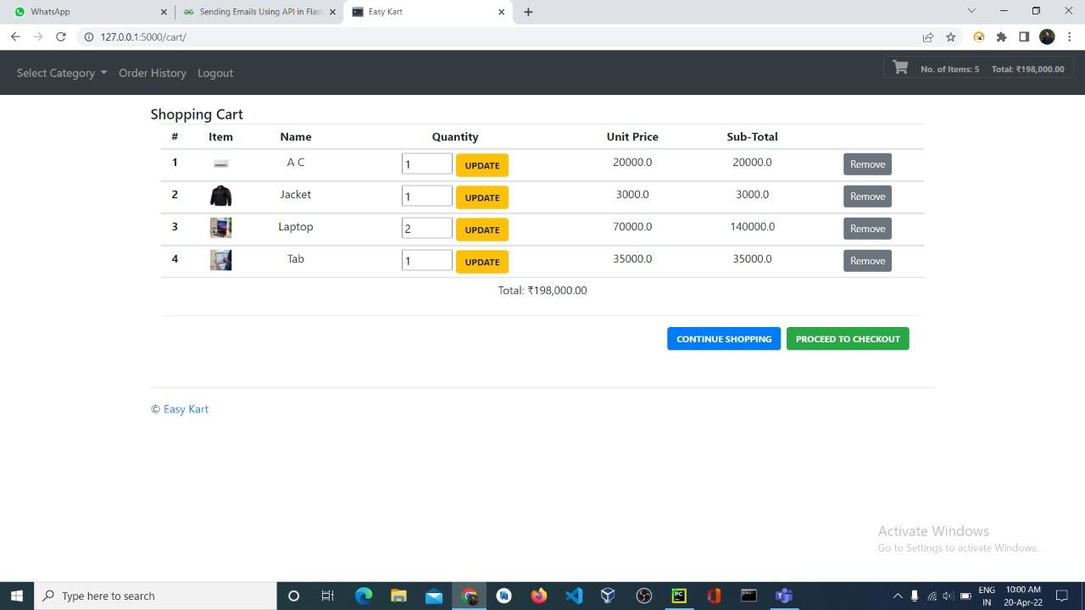

Slide 33
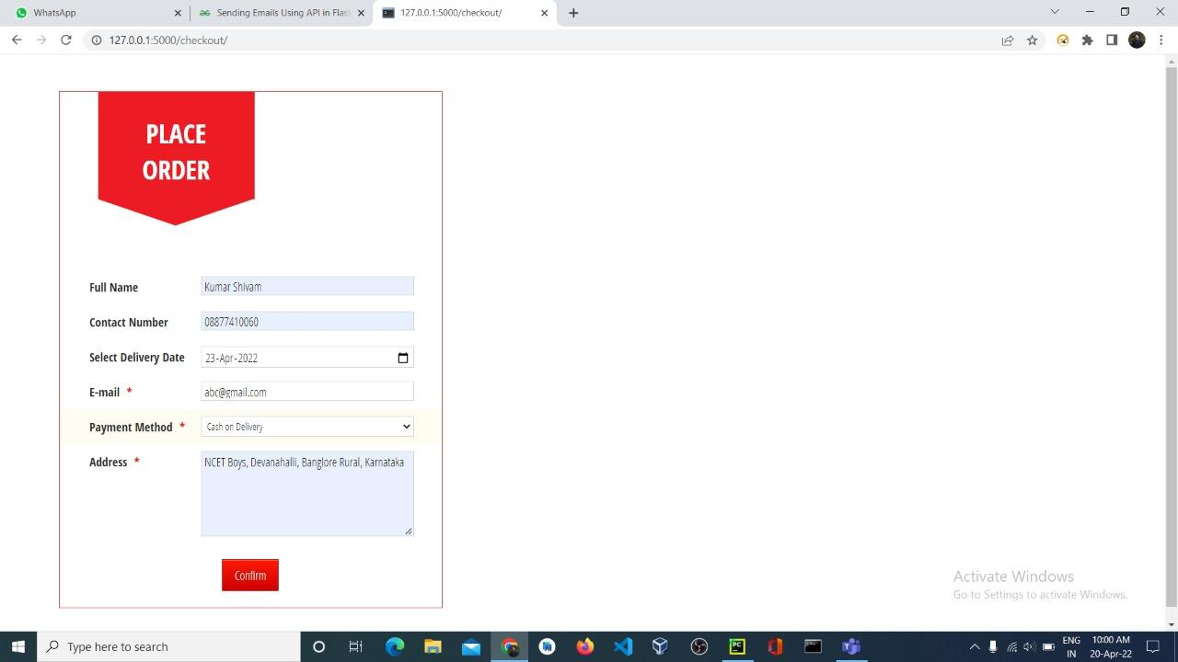

Slide 34
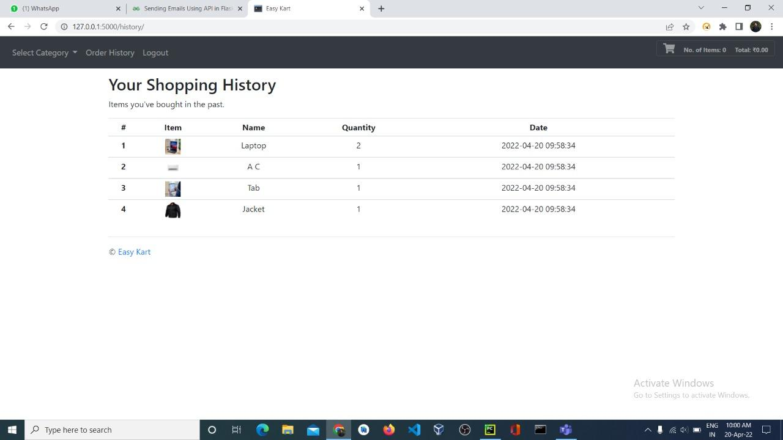

Slide 35
WE WELCOME ALL YOUR DOUBTS

Slide 36


